Slide 1
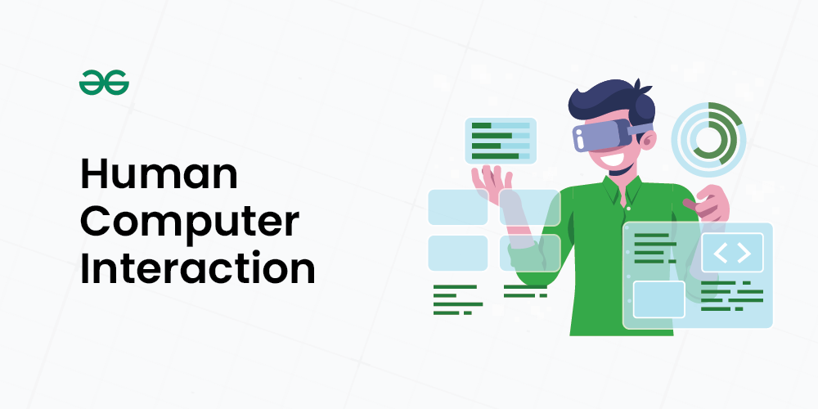
Human-Computer Interaction
Understanding the Connection between Humans and Computers
Abdul Wasay
24k-0744

Slide 2
Agenda slide
Good HCI design involves understanding the user's needs, goals, and behaviors. It requires a deep understanding of human psychology, computer science, and design principles. The following are some key principles of good HCI design:
User-centered design: The design should be centered around the user's needs and goals.
Usability: The system should be easy to use and navigate.
Accessibility: The system should be accessible to all users, regardless of their abilities.
Aesthetics: The system should be visually appealing and engaging.

Slide 3
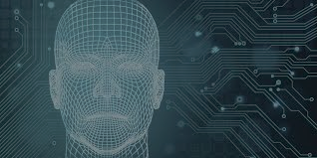
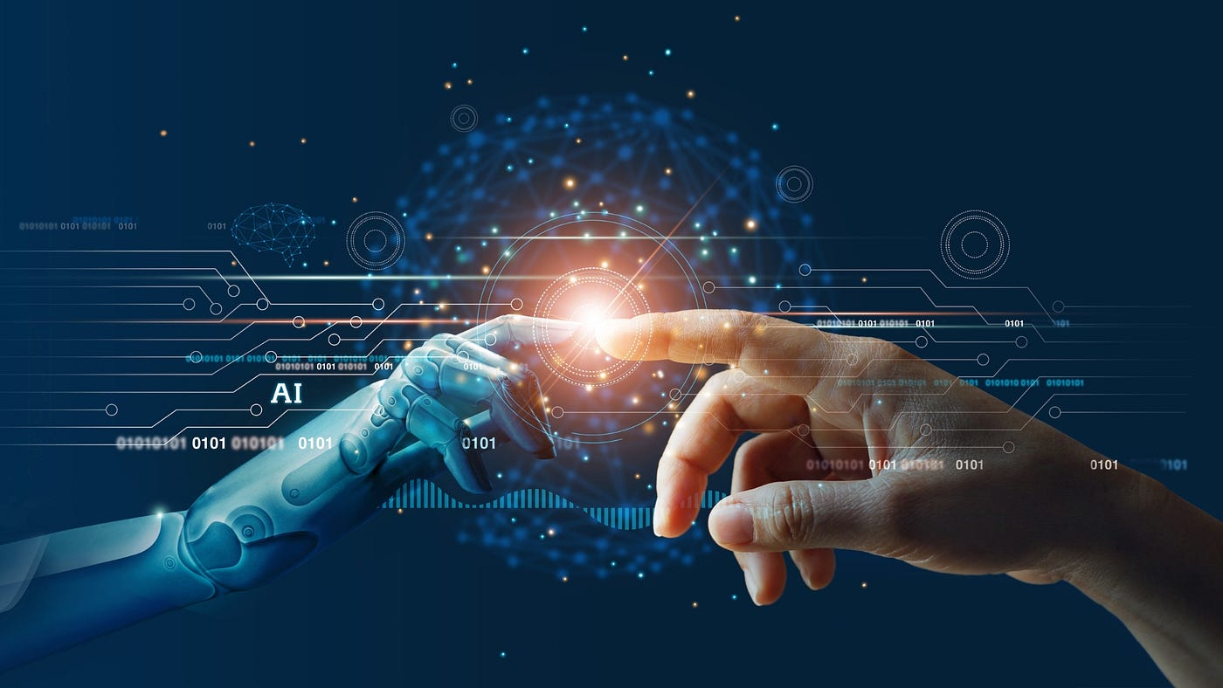
Introduction
Human-Computer Interaction (HCI) is a multidisciplinary field that focuses on the interaction between humans (the users) and computers. It is a crucial aspect of designing computer technology, as it aims to create systems that are easy to use, efficient, and enjoyable for humans. In this essay, we will explore the concept of HCI, its history, and its importance in the design of computer systems.

Slide 4

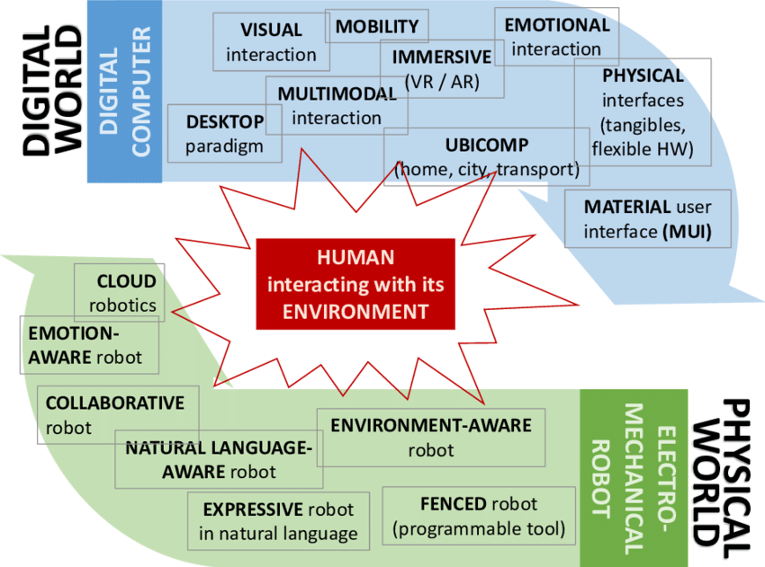
History of HCI
The field of HCI has its roots in the 1980s, when personal computers became widely available. As computers became more accessible, the need for user-friendly interfaces became increasingly important. The first graphical user interface (GUI) was developed in the 1970s, but it was not until the 1980s that HCI became a recognized field of study.

Slide 5
The Meteoric Rise of HCI
The 1980s saw a significant increase in the use of personal computers, and with it, the need for HCI research and development. The introduction of the Apple Macintosh, IBM PC 5150, and Commodore 64 revolutionized the way people interacted with computers. As computers became more widespread, the need for user-centered design became increasingly important.
HUMAN COMPUTER
INTERACTION
Human Factors Engineering
Cognitive
Science
Computer Science

Slide 6
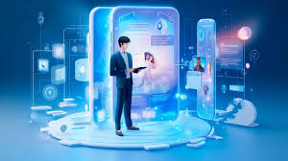
What User Needs / Wants
Analysis
Design
General Flow Of Interaction
Design Process
Prototype
Implement And Deploy
FINAL STEP

Slide 7
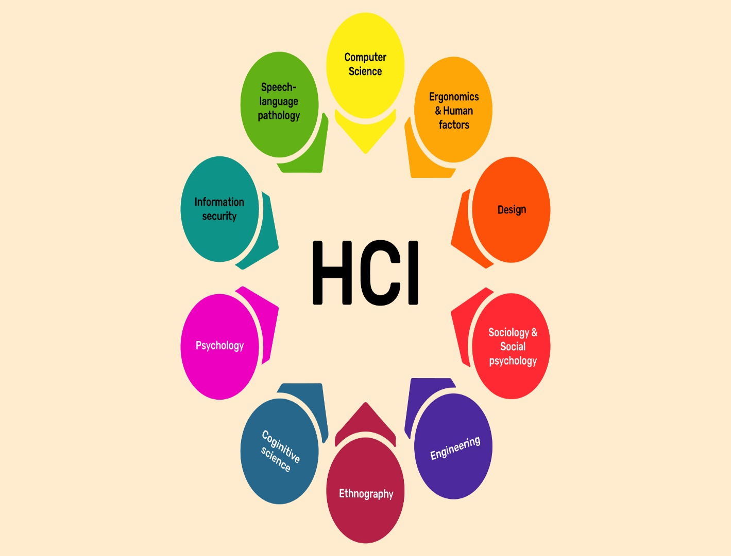
IMPORTANCE OF HCI
The iPhone 4, released in 2010, was a highly anticipated device that was expected to revolutionize the smartphone market. However, it received criticism for its design, particularly the placement of the antenna, which led to poor reception and dropped calls. This example highlights the importance of HCI in the design of computer systems.

Slide 8
Principals of Good HCI Design
Good HCI design involves understanding the user's needs, goals, and behaviors. It requires a deep understanding of human psychology, computer science, and design principles. The following are some key principles of good HCI design:
User-centered design: The design should be centered around the user's needs and goals.
Usability: The system should be easy to use and navigate.
Accessibility: The system should be accessible to all users, regardless of their abilities.
Aesthetics: The system should be visually appealing and engaging.

Slide 9
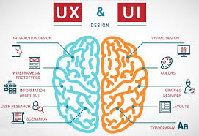
The UX Value of HCI and Its Related Realms
HCI is a broad field that overlaps with areas such as user-centered design (UCD), user interface (UI) design, and user experience (UX) design. In many ways, HCI was the forerunner to UX design.
User experience is the factor that will make someone choose your product over another. Therefore, optimizing the HCI is paramount to ensure the success and competitiveness of a product or service.

Slide 10
Does Human Computer Interaction Require Coding?
HCI does not require any knowledge of coding. While coding can be a part of the design process and implementation, it is not necessary for understanding and applying the principles of human-computer interaction.

Slide 11
Conclusion
Human-Computer Interaction is a crucial aspect of designing computer systems. It involves understanding the user's needs, goals, and behaviors, and designing systems that are easy to use, efficient, and enjoyable. The field of HCI has come a long way since its inception in the 1980s, and it continues to evolve with the development of new technologies.

